Slide 1


Jaydeep Jitendra
26/10/2021

Slide 2

Outline
Executive Summary
Introduction
Methodology
Results
Conclusion
Appendix

Slide 3
Executive Summary
Summary of methodologies
Summary of all results

Slide 4
Introduction
In this project we will try to predict if Falcon 9 first stage will land successfully or not by using previous data different regression analysis.
We will discuss through the problem and how to find solutions:
Data Collection and cleaning the data.
Exploratory data analysis.
Build a dashboard to analyse the launch records interactively.
Build an interactive map to analyse the launch site proximity.
Apply machine learning methods to build a predictive model.

Slide 5


Slide 6
Methodology
Executive Summary
Data collection methodology:
Data was collecting from past SpaceX missions. From below URL
https://api.spacexdata.com/v4/launches/past
Perform data wrangling
Calculated the number of launches on each site
Calculated number and occurrences of each orbit
Calculated the number and occurrence of mission outcome per orbit type
Created a landing outcome label from Outcome column
Perform exploratory data analysis (EDA) using visualization and SQL
Perform interactive visual analytics using Folium and Plotly Dash
Perform predictive analysis using classification models

Slide 7
Data Collection
Data sets were collected from previous SpaceX mission and Wikipedia pages and below processes were obtained to clean the data.
SpaceX API
Web Scrapping
Data Wrangling

Slide 8
Data Collection – SpaceX API
https://github.com/jaydeep-j/SpaceX_Capstone_Project/blob/3618ca004d94447e2e8915fed647431d61071466/jupyter-labs-spacex-data-collection-api.ipynb
Request and parse the SpaceX launch data using the GET request
Filter the Data frame to only include Falcon 9 launches
Replace Missing Values with mean Value

Slide 9
Data Collection - Scraping
https://github.com/jaydeep-j/SpaceX_Capstone_Project/blob/master/jupyter-labs-webscraping.ipynb
Request the Falcon9 Launch Wiki page from its URL
Extract all column/variable names from the HTML table header
Create a data frame by parsing the launch HTML tables

Slide 10
Data Wrangling
Calculate the number of launches on each site
Calculate the number and occurrence of each orbit
Calculate the number and occurrence of mission outcome per orbit type
Create a landing outcome label from Outcome column
https://github.com/jaydeep-j/SpaceX_Capstone_Project/blob/master/labs-jupyter-spacex-Data%20wrangling.ipynb

Slide 11
EDA with Data Visualization
Plotted below charts to understand the data.
Flight Number Vs Payload variables, how it would affect the launch outcome.
Flight Number vs Launch Site
Payload vs Launch Site
Success rate vs Orbit type
Flight Number vs Orbit type
Payload vs Orbit type
launch success yearly trend
https://github.com/jaydeep-j/SpaceX_Capstone_Project/blob/master/jupyter-labs-eda-dataviz.ipynb

Slide 12
EDA with SQL
Display the names of the unique launch
Display the total payload mass carried by boosters
List the total number of successful and failure mission outcomes.
List the records which will display the month names, failure landing_outcomes in drone ship ,booster versions, launch_site for the months in year 2015
Rank the count of successful landing_outcomes between the date 2010-06-04 and 2017-03-20 in descending order.
List the date when the first succesful landing outcome in ground pad was acheived.
https://github.com/jaydeep-j/SpaceX_Capstone_Project/blob/master/jupyter-labs-eda-sql-coursera.ipynb

Slide 13
Build an Interactive Map with Folium
Mark all launch sites on a map
Add folium.Circle & folium.Marker on each site
Mark the success/failed launches for each site on the map
Calculate the distances between a launch site to its proximities
Calculate the distance to nearest railway
Use polyline function to show the distance
The launch success rate may depend on many factors such as payload mass, orbit type, and so on. It may also depend on the location and proximities of a launch site, i.e., the initial position of rocket trajectories. Finding an optimal location for building a launch site certainly involves many factors.
https://github.com/jaydeep-j/SpaceX_Capstone_Project/blob/master/lab_jupyter_launch_site_location%20with%20Folium.ipynb

Slide 14
Build a Dashboard with Plotly Dash
Summarize what plots/graphs and interactions you have added to a dashboard
Explain why you added those plots and interactions
Add the GitHub URL of your completed Plotly Dash lab, as an external reference and peer-review purpose

Slide 15
Predictive Analysis (Classification)
Use the function train_test_split to split the data X and Y into training and test data
Create a logistic regression object and calculate the accuracy
Create a support vector machine object and calculate the accuracy
Create a decision tree classifier object and calculate the accuracy
Create a k nearest neighbors object and calculate the accuracy
Find the best performing method
Split the data for training and testing, and performed regression analysis methods such as SVM, Classification trees and Logistic Regression to find the best hyperparameters and accuracy of the model.
https://github.com/jaydeep-j/SpaceX_Capstone_Project/blob/master/SpaceX%20Machine%20Learning%20Predictive%20Analysis.ipynb

Slide 16
Results
Exploratory data analysis results
Interactive analytics demo in screenshots
Predictive analysis results

Slide 17


Slide 18
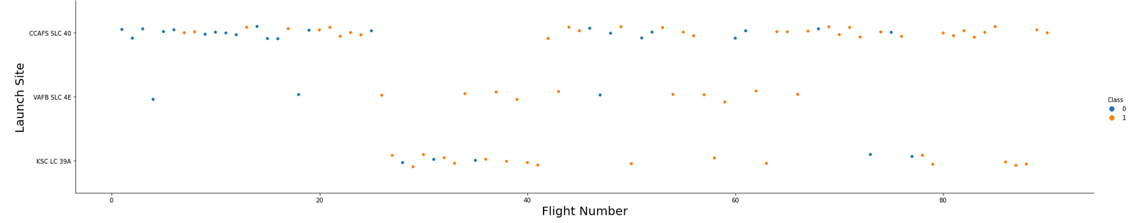
Flight Number vs. Launch Site
Scatter plot of Flight Number vs. Launch Site
Explanation:

Slide 19
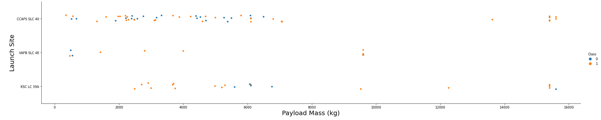
Payload vs. Launch Site
Scatter plot of Payload vs. Launch Site
Explanations

Slide 20
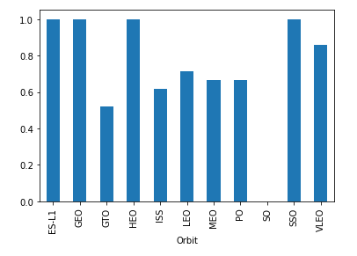
Success Rate vs. Orbit Type
Bar chart for the success rate of each orbit type
Explanations

Slide 21
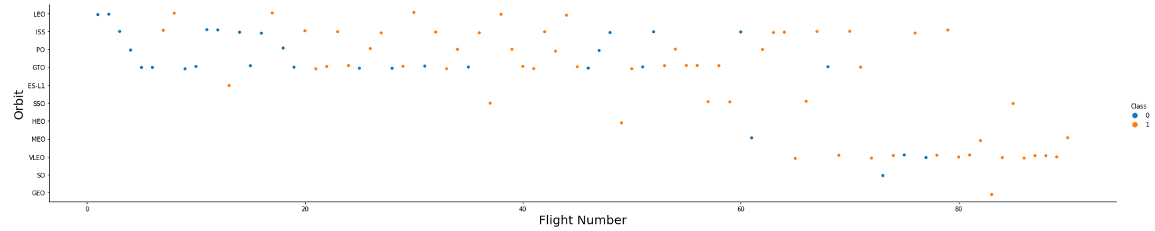
Flight Number vs. Orbit Type
Scatter point of Flight number vs. Orbit type
Explanations

Slide 22
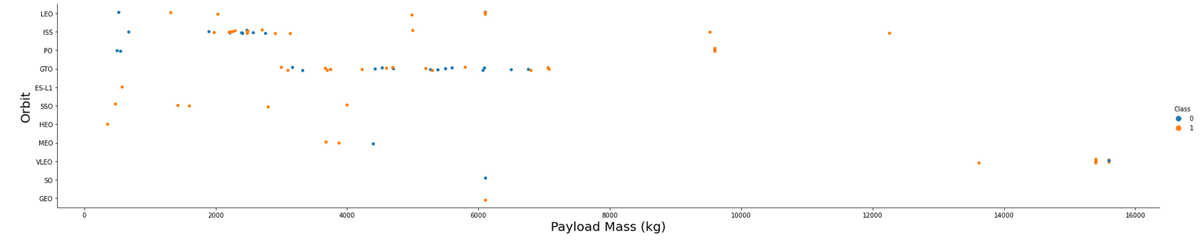
Payload vs. Orbit Type
Scatter point of payload vs. orbit type
Explanations

Slide 23
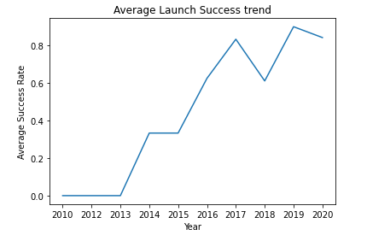
Launch Success Yearly Trend
Line chart of yearly average success rate.
Explanations

Slide 24
All Launch Site Names
Names of the unique launch sites:
Cape Canaveral Space Launch Complex 40 VAFB SLC 4E
Vandenberg Air Force Base Space Launch Complex 4E (SLC-4E)
Kennedy Space Center Launch Complex 39A KSC LC 39A
Present your query result with a short explanation here

Slide 25
Launch Site Names Begin with 'CCA'
5 records where launch sites begin with `CCA`
DATE | time__utc_ | booster_version | launch_site | payload | payload_mass__kg_ | orbit | customer | mission_outcome | landing__outcome
2010-06-04 | 18:45:00 | F9 v1.0 B0003 | CCAFS LC-40 | Dragon Spacecraft Qualification Unit | 0 | LEO | SpaceX | Success | Failure (parachute)
2010-12-08 | 15:43:00 | F9 v1.0 B0004 | CCAFS LC-40 | Dragon demo flight C1, two CubeSats, barrel of Brouere cheese | 0 | LEO (ISS) | NASA (COTS) NRO | Success | Failure (parachute)
2012-05-22 | 07:44:00 | F9 v1.0 B0005 | CCAFS LC-40 | Dragon demo flight C2 | 525 | LEO (ISS) | NASA (COTS) | Success | No attempt
2012-10-08 | 00:35:00 | F9 v1.0 B0006 | CCAFS LC-40 | SpaceX CRS-1 | 500 | LEO (ISS) | NASA (CRS) | Success | No attempt
2013-03-01 | 15:10:00 | F9 v1.0 B0007 | CCAFS LC-40 | SpaceX CRS-2 | 677 | LEO (ISS) | NASA (CRS) | Success | No attempt

Slide 26
Total Payload Mass
Total payload carried by boosters from NASA
Present your query result with a short explanation here
total_payload_mass
45596

Slide 27
Average Payload Mass by F9 v1.1
Average payload mass carried by booster version F9 v1.1
Present your query result with a short explanation here
average_payload_mass
2928

Slide 28
First Successful Ground Landing Date
Dates of the first successful landing outcome on ground pad
Present your query result with a short explanation here
first_succesful_landing
2015-12-22

Slide 29
Successful Drone Ship Landing with Payload between 4000 and 6000
Names of boosters which have successfully landed on drone ship and had payload mass greater than 4000 but less than 6000
Present your query result with a short explanation here
booster_version
F9 FT B1022
F9 FT B1026
F9 FT B1021.2
F9 FT B1031.2

Slide 30
Total Number of Successful and Failure Mission Outcomes
Total number of successful and failure mission outcomes
Present your query result with a short explanation here
mission_outcome | 2
Failure (in flight) | 1
Success | 99
Success (payload status unclear) | 1

Slide 31
Boosters Carried Maximum Payload
booster_version | payload_mass__kg_
F9 B5 B1048.4 | 15600
F9 B5 B1048.5 | 15600
F9 B5 B1049.4 | 15600
F9 B5 B1049.5 | 15600
F9 B5 B1049.7 | 15600
F9 B5 B1051.3 | 15600
F9 B5 B1051.4 | 15600
F9 B5 B1051.6 | 15600
F9 B5 B1056.4 | 15600
F9 B5 B1058.3 | 15600
F9 B5 B1060.2 | 15600
F9 B5 B1060.3 | 15600
F9 B5 B1049.6 | 15440
F9 B5 B1059.3 | 15410
F9 B5 B1051.5 | 14932
Names of the booster which have carried the maximum payload mass
Present your query result with a short explanation here

Slide 32
2015 Launch Records
Failed landing_outcomes in drone ship, their booster versions, and launch site names for in year 2015
Present your query result with a short explanation here
MONTH | landing__outcome | booster_version | launch_site
1 | Failure (drone ship) | F9 v1.1 B1012 | CCAFS LC-40
4 | Failure (drone ship) | F9 v1.1 B1015 | CCAFS LC-40

Slide 33
Rank Landing Outcomes Between 2010-06-04 and 2017-03-20
Rank the count of landing outcomes (such as Failure (drone ship) or Success (ground pad)) between the date 2010-06-04 and 2017-03-20, in descending order
Present your query result with a short explanation here
landing__outcome | 2
Success (ground pad) | 3
Success (drone ship) | 5

Slide 34


Slide 35
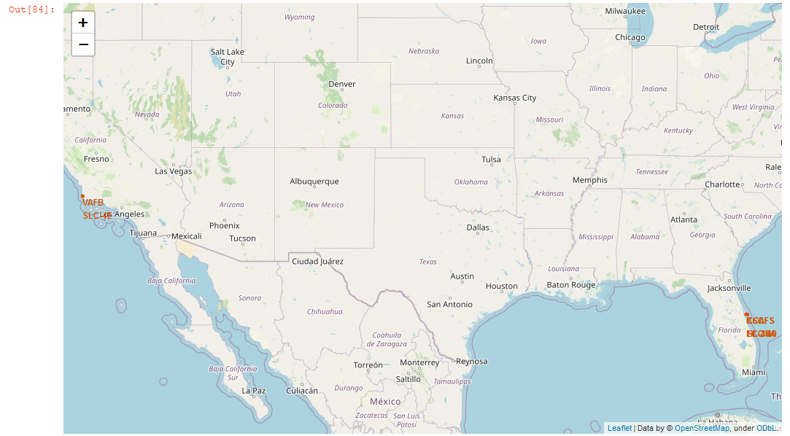
All Launch Sites on Map
Explain the important elements and findings on the screenshot

Slide 36
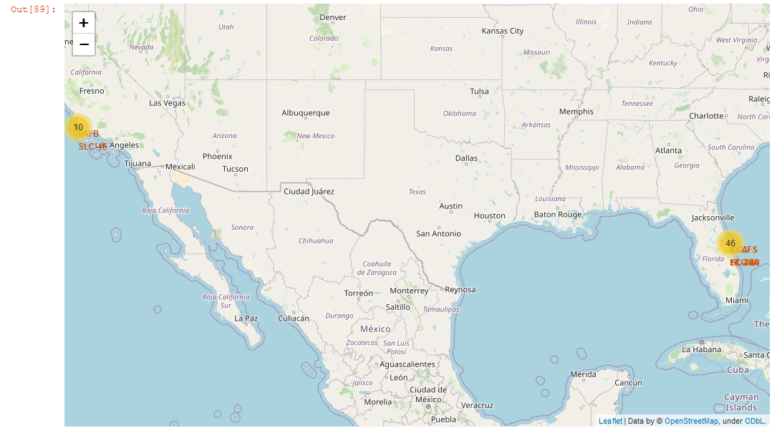
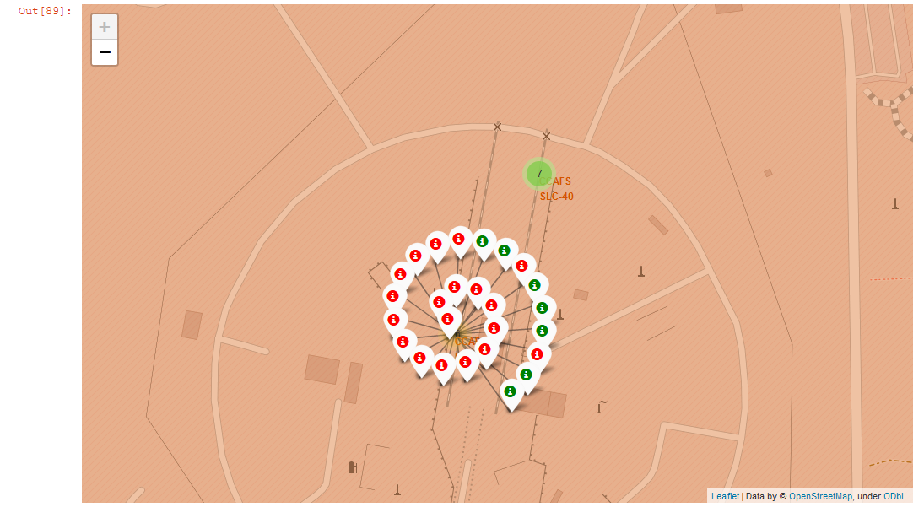
Success/failed launches for each site on the map
Explain the important elements and findings on the screenshot

Slide 37
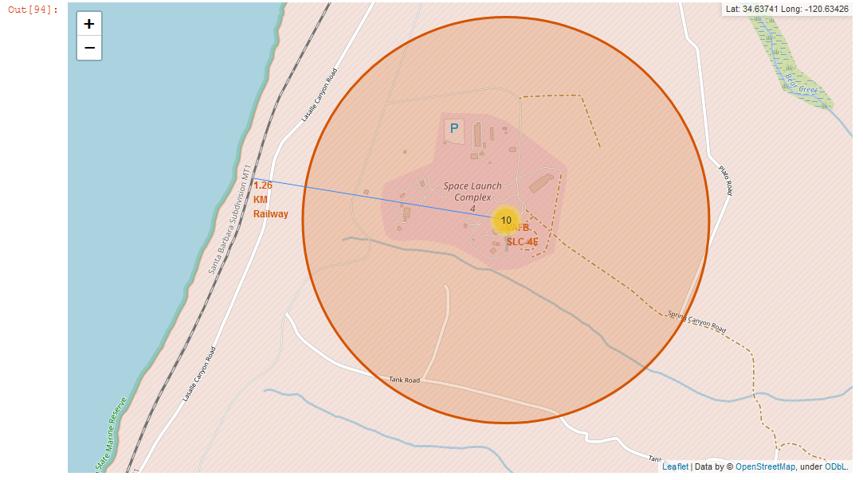
<Folium Map Screenshot 3>
Explain the important elements and findings on the screenshot

Slide 38


Slide 39
<Dashboard Screenshot 1>
Replace <Dashboard screenshot 1> title with an appropriate title
Show the screenshot of launch success count for all sites, in a piechart
Explain the important elements and findings on the screenshot

Slide 40
<Dashboard Screenshot 2>
Replace <Dashboard screenshot 2> title with an appropriate title
Show the screenshot of the piechart for the launch site with highest launch success ratio
Explain the important elements and findings on the screenshot

Slide 41
<Dashboard Screenshot 3>
Replace <Dashboard screenshot 3> title with an appropriate title
Show screenshots of Payload vs. Launch Outcome scatter plot for all sites, with different payload selected in the range slider
Explain the important elements and findings on the screenshot, such as which payload range or booster version have the largest success rate, etc.

Slide 42


Slide 43
Classification Accuracy
Decision tree classifier has the best accuracy.

Slide 44
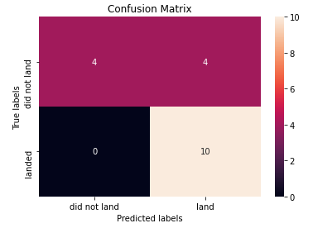
Confusion Matrix
Confusion matrix of the best performing model with an explanation

Slide 45
Conclusions
Point 1
Point 2
Point 3
Point 4
…

Slide 46
Appendix
Include any relevant assets like Python code snippets, SQL queries, charts, Notebook outputs, or data sets that you may have created during this project

Slide 47


